Slide 1
STRATEGIC PLAN 2020-2023
CROQUET NSW

Slide 2
INTRODUCTION
The modern game is reputed to have started in Ireland in the 1830s and taken to England during the 1850s.
It became an instant success, one reason being because it provided the first opportunity for women to participate in an outdoor sport on an equal basis with men”.
Dr Ian Plummer Oxford Croquet
“How to play Croquet” dated 1878, gives an insight into how the sport was promoted at the time:
“Croquet upon its introduction into society should meet with so warm and universal a welcome. It comes as an outdoor sport for the men, ladies, misses, and even little children, -for the rich and for the poor; the strong and the weak, easily learned, and always intensely interesting and attractive to all.
Croquet in NSW has a proud history, from its first tournament between seven founding clubs at the Sydney Cricket Ground in 1906. To the now 70 clubs in 2020 throughout the State.
Croquet provides an opportunity to engage in an inclusive, rewarding and competitive sport.
Participants range from social players to International representatives.
Croquet and mallet sports prides itself on the welcoming and nurturing culture within its clubs and the wider croquet family and positive engagement with their local community.
Croquet NSW acknowledges the original owners, past, present and emerging of the lands on which we play our sport.
This plan provides an outline of how we will achieve success, enjoyment, growth and development of the sport in the 21st Century.

Slide 3
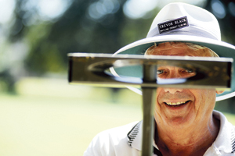
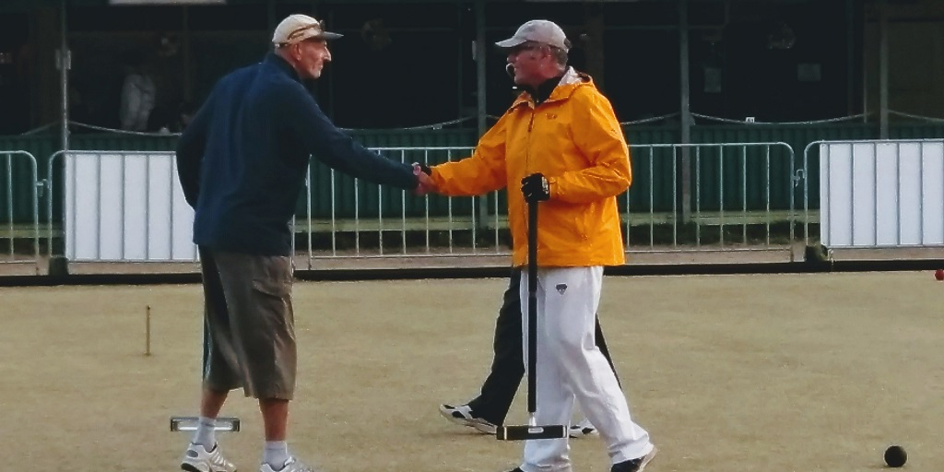
OUR VISION FOR CROQUET IN NSW
A thriving Sport with an inclusive image
OUR MISSION
Croquet NSW is a sustainable organisation that:
Actively engages with clubs, members and the wider community.
Welcomes all people to participate
Supports member clubs to achieve their potential
Raises the profile of the sport
Promotes Croquet excellence and supports the National and International Croquet community

Slide 4
OUR CORE VALUES What is Important to CNSW ?
Being inclusive
Encouraging an active and healthy lifestyle
Being welcoming, enthusiastic, friendly and having fun
Recognising volunteers
Being open minded
Having integrity
Promoting equity
Being transparent
Achieving our goals

Slide 5
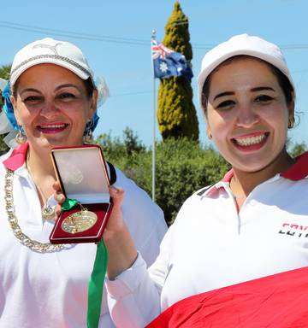
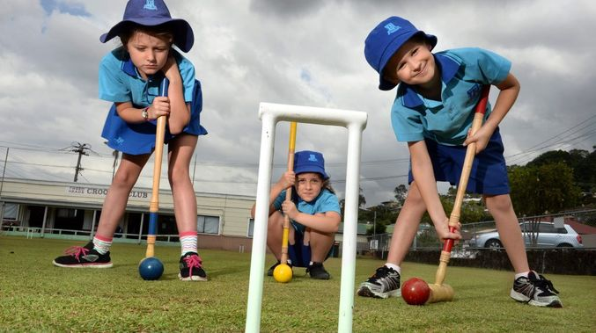
WHO ARE OUR STAKEHOLDERS?
All Clubs
All Players and potential Players
Our Communities
The Office of Sport and Sport NSW
The original owners of the Land on which we play.
Local Councils and NSW State Government
Australian Croquet Association
Sport Australia
World Croquet Federation
Sponsors

Slide 6
OUR 5 PILLARS
Volunteers, Managers, Referees and Coaches
Croquet NSW recognises the valuable contribution made by our volunteers to the Sport. We need to ensure that our volunteers and officials receive the support and training necessary for them to carry out their roles in a positive and welcoming manner. We should recognise their areas of expertise and ensure that they are included in decision-making processes.
Governance and Finance
Croquet NSW recognises the need to continually improve the administration and governance of the Sport. Policies and procedures need to be regularly reviewed and revised. Croquet NSW is aware of its responsibility to deliver a high standard of financial management and to explore opportunities to increase revenue whilst ensuring affiliation fees meet the needs of the membership and the organisation.
Internal Communication and Club Support
We need to ensure that the communication between officials, clubs and players is transparent, accurate and meaningful. Croquet NSW recognises the importance of integrity and clarity in all communications with its member clubs, players and stakeholders.
Marketing Promotion and External Communication
Croquet NSW recognises that the survival and growth of croquet relies on Croquet NSW promoting and marketing the sport to the community. The sporting, recreational, health and social benefits of the sport are its key selling points. Croquet is a sport for all ages and Croquet NSW needs to convey that message to the community. Croquet NSW will continue to seek and develop partnerships with government and private sector stakeholders.
Coaching, Player Development and Competition
Croquet NSW recognises the value of teaching new players all codes of Croquet. Croquet NSW also needs to provide ongoing training for the development of coaches and referees in all clubs – city and country. Croquet NSW needs to provide coaching and development opportunities to players at all levels of the sport. Croquet provides sport and recreational opportunities to a wide range of athletes. Croquet NSW needs to provide playing opportunities that encourage and challenge players at social, club, state, national and international levels. Croquet NSW needs to support both city and country clubs in these endeavours
.

Slide 7
Governance & Finance
KEY AREAS | Governance | Finance | Outcomes
Actions 2020 | Create a new Constitution Use feedback from the Office of Sport “Organisation Health Survey” to ensure ongoing revision and compliance. Finalise Strategic Plan 2020-2023 and deliver. Update Risk Management template, with a focus on Child Safety compliance. Sense check and review all Policies. Invite and Fund 5 Clubs to become Croquet Academies across the State Create a Board Succession Plan | Review current Finance Policy re: best practice and risk management assessment as per the “Organisational Health Survey” Implement transparent and accountable procedures,via accurate data collection and procedures. Establish Grants Committee Commence Plan to run Financial year from Jan to Dec. Adjust Constitution requirement for Audit. | Improved 2020 Health Survey result >60/90 Tier 1 >15/18 Tier 2 Alignment with ACA Fee and Insurance structures.
Actions 2021 | Review the first year implementation of the New Constitution, amend as required. Review Strategic Plan Produce new Policies as required. Follow up all clubs for a compliant Constitution Enact Board Succession Plan | Complete changeover to Jan/ Dec trading year. Complete a comprehensive Data base of members. Check accuracy of all CNSW financial data. Produce a brief Financial Audit tool. Investment review. | Clubs and Association have a compliant Constitution and a Good Governance self audit process in place. All club level and State Policies are compliant and appropriate. Club Audit results > 95%
Actions 2022 | Review and Update all commitments and adjust time frames if required. Policy review | Undertake future proofing financial review for croquet. Project revenue for the next 4 years. SWOT analysis of current financial technology that could help Croquet | Improved feedback from Clubs in relation to transparency, good governance, inclusion. Improved real membership growth of 15% o the previous 2 years.
Actions 2023 | Produce a governance improvement scorecard, implement. | Investment review. | Happier clubs, greater participation Improved financial position.
Croquet NSW will follow guidelines provided in the CNSW Constitution and Policies in conjunction with the expectations of Sport NSW.
CNSW will apply an appropriate risk management strategy to all its actions.CNSW are committed to accountable, ethical and transparent actions that deliver compliant and enhanced outcomes for clubs and their members.
Croquet NSW will be actively inclusive and supportive of all clubs in relation to their own Governance and compliance.

Slide 8
Marketing & External Communication
KEY AREAS | Marketing | Promotion | External Communication | Outcomes
Actions 2020 | New Website Improved functionality for people looking to play croquet as well as members. Create an “outward looking” Media Policy LOGO repositioning Help clubs develop their own FB page, Insta presence. | Seniors Day World Croquet Day Xmas Function Club Marketing Workshops throughout the year. Advance preparation for 2021 Interstate. Access to all members email addresses. Friends with every croquet FB page Introduce School Sport “Come and Try” morning Tea for local teachers. | Social Media including Google Analytics Instagram Use of video/ You Tube as a promotion tool at expos and membership drives. Develop an on line and hard copy media kit, for CNSW and clubs. Develop a “Come and Try Kit “ for Shopping Centres and schools. | More and better touch points. Better engagement measured via satisfaction index.
Actions 2021 | Position Croquet as a family sport. Grandparents coaching grand kids and their friends. Kids challenging parents. | Host the Eire Cup Host the Australian Open Patrons Trophy Seniors Day World Croquet Day Xmas Function Club Marketing Workshops | Media Release all events Live Streaming important events. Continuing 2020 initiatives. Introduce a CNSW YouTube Group | Uplift in Recognition outside the community. Happier clubs and members.
Actions 2022 | Celebrate diversity in Croquet. Age Groups Abilities Community Support Competition and Fun | Host the Women's World Championship GC Seniors Day World Croquet Day Xmas Function Club Marketing Workshops | Live Streaming from quarter finals. Croquet is for everyone. Message via merchandise. Update as technology changes. | Better participation. Better external profile.
Actions 2023 | Target Croquet is a “real” sport. Target Croquet for Health | Host the GC Interstate Seniors Day World Croquet Day Club Workshops | Live Streaming Source a famous older healthy spokes person for croquet | Recognition as Healthy Sport
Croquet NSW will expand membership by raising the profile of croquet within the community. CNSW will use effective marketing strategies to increase the sustainability of the sport.
Croquet NSW will also develop partnerships with Government and private sector stakeholders and sponsors to foster better community and sporting links throughout NSW.
KEY
AREAS
Governance
Finance
Grants
Policies
Outcomes
Actions 2020
Actions 2021
Actions 2022
Actions 2023

Slide 9
Volunteers, Referees & Coaches
KEY AREAS | Volunteers | Referees | Coaching
Actions 2020 | All Volunteers to complete “Play by Rules” on line Course. Recognise and value all Volunteers with annual awards. Ensure that the Board direction is clear to volunteers and clubs. Encourage and educate volunteers to actively support change and welcome feedback. Promote a positive image and generosity of spirit within clubs. Celebrate Volunteers Day every Year in every Club. | All referees to complete “Play by Rules” on line Course. Ensure Referees are supported in maintaining their qualifications. Identify 8 new referees in each of AC, GC, Gateball and Ricochet. Referee preparation for 2021 Interstate. Help selectors identify new and upcoming talent. Recruit 3 new examining referees. AC and GC. | All Coaches to complete “Play by Rules” on line Course. 30/6/2020. Coaches to obtain their WWCC. Develop Risk Management Checklist for Coaching Courses. Adaptation and state-wide delivery of PPEP Course by Coaches. 2x Coach the Coach Courses in each Croquet Academy Club. Develop a fixture on top of hoops to identify its number. [ training tool] Develop a 45min schools coaching tool, primary and secondary. Coaching videos uploaded to YouTube. Help selectors identify new and upcoming talent.
Actions 2021 | Encourage clubs to contribute and take ownership of CNSW. Submit 2 nominees for NSW and Australian Volunteers and Australian Honours List. | Identify 12 new referees in each of AC, GC, Gateball and Ricochet Provide appropriately qualified referees and Head Referee for the 2021 AC Interstate | Develop and Implement a course that encourages AC players to play GC, and GC to play AC. Develop 8 Level 1 Coaches Develop 4 Level 2 Coaches Develop 1 Level 3 Coach
Actions 2022 | Subsidise a First Aid accreditation for Volunteers include defibrillator. | Promote 3 referees to the ACA as International Referees | Progress previous years accredited Coaches to the next level and recruit 8 more Level 1 Coaches, AC, GC and Gateball.
Actions 2023 | Review and update volunteer support and training across the sport | Instigate biannual referees workshops in all codes. | Recruit 3 coaches under 35 years old.
Croquet NSW relies on its volunteers to develop and administer the sport.
We need to provide proper accreditation, training and support for our volunteers. Croquet NSW publicly recognises the time and effort and expertise provided by Volunteers and Officials and appreciates that support.
Croquet NSW recognises the need for all Clubs to be part of the decision making process. Clubs need to work with Croquet NSW to implement change and develop the sport.

Slide 10
Internal Communication & Club Support
KEY AREAS | CNSW Support for Clubs | Internal Communication | Club Culture
Actions 2020 | Listen and respond to requests Workshops Regular opportunities to feedback via website contact page. Update all on line tools and resources New Website | Monthly Newsletter Facebook Instagram Communication direct to members not just clubs | Member Protection Officer is supported by 3 other qualified mediators. Mediation becomes the first step before formal complaints.
Actions 2021 | Listen and respond to requests Support Clubs and provide tools to help achieve great relationships in their local communities. Seek access to free counselling opportunities for members, for bereavement, job loss, depression, isolation. | Monthly Newsletter Facebook Instagram Communication direct to members not just clubs You tube Page | Instigate the club members annual happiness barometer tool and act on the results.
Actions 2022 | Listen and respond to requests Updated and develop new Workshops Update all on line tools and resources | Monthly Newsletter Facebook Instagram Communication direct to members not just clubs You tube Page | Provide Clubs with inclusiveness and resilience workshops.
Actions 2023 | Listen and respond to requests. Instigate a contact email tree. | Monthly Newsletter Facebook Instagram Communication direct to members not just clubs You tube Page | Action as required
CNSW must ensure clubs are receiving regular and informative communications that supports their enjoyment, knowledge and experience of the game.

Slide 11
Coaching, Player Development & Competition
KEY AREAS | Events and Competitions | Player Development | Representative Teams
Actions 2020 | Calendar review to align with National and International tournament Calendar. Calendar to encourage participation and engagement. Introduce Mixed Doubles AC and GC Reinstate prizemoney for events. Support social tournament rounds with Information on draws and interesting formats. | Identify emerging talent and mentor with senior players. Use referees, State Handicapper and coaches as support. Develop Alternate Stroke Doubles as a preferred development tool. Engage current State Team players as resources. Instigate Schools Croquet Program. Mentor 4 new female improvers. | Provide adequate funding to enable State Teams to represent NSW successfully. Seek $5000 sponsorship in cash or in kind. Plan to win the GC Interstate within the next 3 years.
Actions 2021 | Encourage club/mentoring and event support between city/country clubs. Introduce individual invitations to players for events. TC to have access to member list. Bid for upcoming Australian and International Events. | Encourage developing Players to become coaches and referees. Aim to have 16 NSW Players competing in the Australian Eights Competition. Have a clear second Tier Squad Identify and mentor 8 new rapid improvers under 18 years old | Win the AC Interstate at home Players to seek ongoing sponsorship for the next 3 years.
Actions 2022 | Adjust existing and develop new events as required. Develop further ways to grow participation. | Identify 6 rapid Improvers and support them to play in the Victorian Open, The QLD Open or the SA Open of their discipline. Have a clear third Tier Squad | Win the AC and GC Interstate. State team Players to play in at least 2 NSW regional events.[ 3 day events]
Actions 2023 | Develop evening Leagues at Croquet Academies. | Identify 2 rapid improvers and pay their entry into the New Zealand Open Event of their discipline. | Aim to have 4 NSW Players in Australian Representative Teams
Croquet NSW needs to provide coaching and development opportunities for players at all levels of the sport in all codes.
CNSW recognises that trained coaches are essential to the development of playing standards.
Croquet NSW recognises the need to provide competition to players in all member categories and at all levels of the sport across the state. This provides a challenge and development opportunities to players.

Slide 12
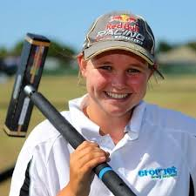
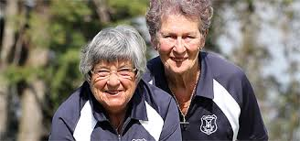
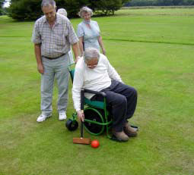
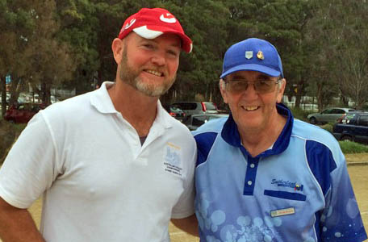
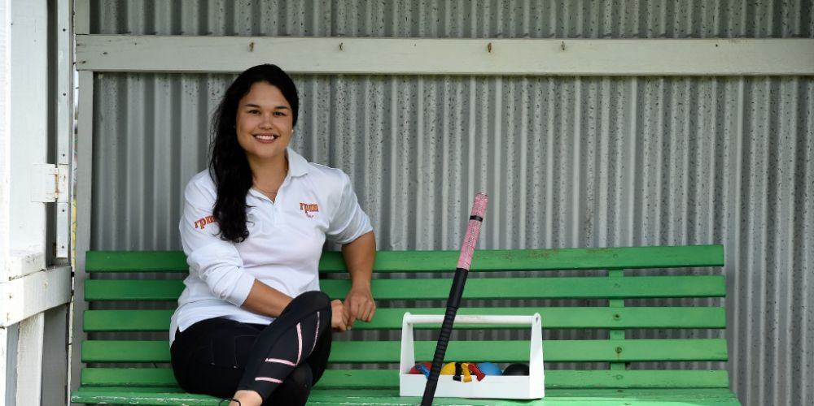
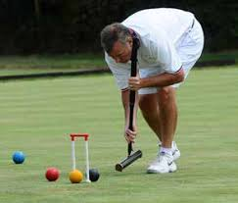
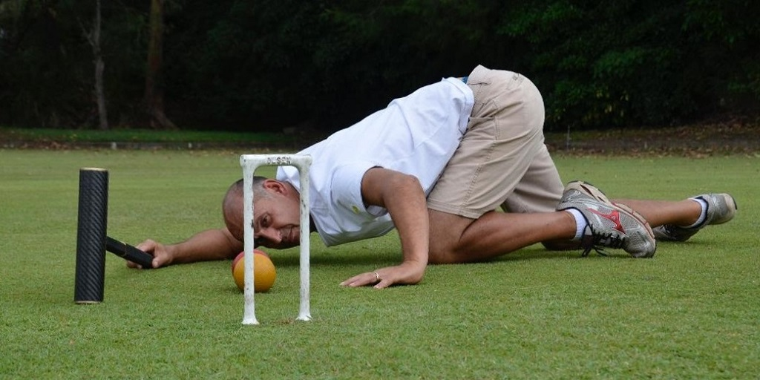
“HEAD DOWN AND FOLLOW THROUGH !”
Great Croquet advice the World over.

